Slide 1
Volcanoes
Super Volcanoes: Naked Science

Slide 2
What is a Volcano?
A volcano is a weak spot in the crust where molten material, magma, from the mantle comes to Earth’s surface.
Magma – a molten mixture of rock-forming substances, gases and water.
When magma reaches the surface of Earth it is called lava.
When lava cools it creates new solid rock.

Slide 3
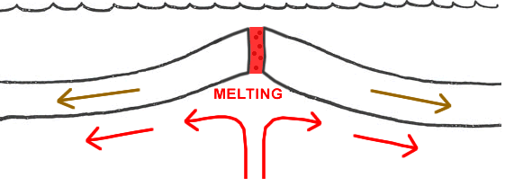
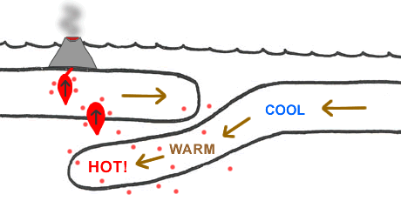
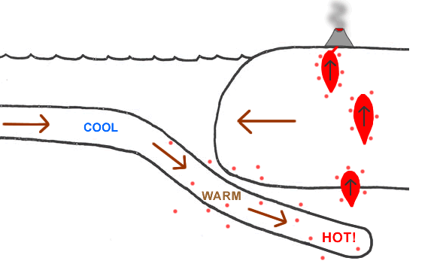
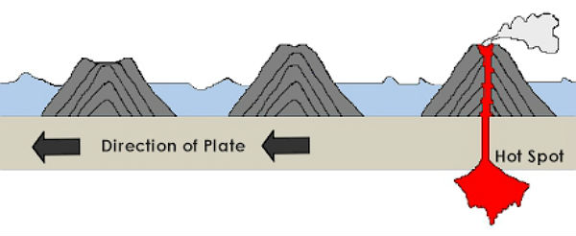
Location of Volcanoes
Volcanoes can be found at three locations:
Divergent Boundaries
Mid-Ocean Ridge
Convergent Boundaries
Subduction zones
Hot spots
Stationary openings in the mantle where magma melts through the crust.
As the plate moves off the hot spot a new island forms, island chain.
Oceanic vs. Oceanic
Oceanic vs. Continental
Subduction Zone

Slide 4
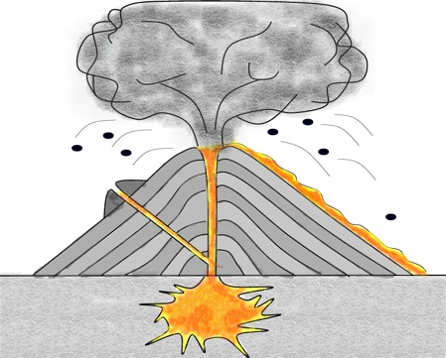
Inside a Volcano
Vent
Crater
Side Vent
Lava
Pipe
Magma Chamber/
Magma

Slide 5
Inside a Volcano
Magma – molten material that contains dissolved gases and water vapor.
Characteristics of Magma:
Develops in the asthenosphere of the mantle.
Under great pressure and heat
Less dense than solid rock
Due to density and temperature it rises.
Magma Chamber – A large underground pocket where rising magma collects.

Slide 6
Inside A Volcano
Pipe – narrow, vertical crack through which magma rises to the surface of Earth.
Vent – The point on the surface where magma leaves the volcano’s pipe.
Crater – The bowl-shaped area that forms around the volcano’s vent.
Lava – Magma that reaches the surface.

Slide 7
Types of Eruptions
How explosive a volcanic eruption is depends on its silica content.
Silica – a material that is formed from the elements oxygen and silicon.
The more silica magma contains the thicker it is.
Two types of eruptions:
Quiet
Explosive

Slide 8
Quiet Eruptions
Easy flowing magma: (little silica)
Dissolved gases bubble out gently
Thin, runny lava oozes from the vent.
Lava flows many kilometers from the vent.
Two types of lava are produced from quiet eruptions:
Pahoehoe
Aa

Slide 9
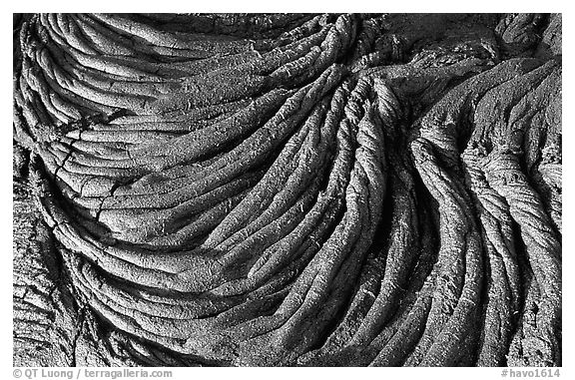
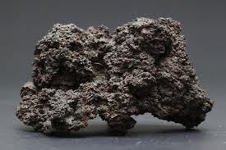
Quiet Eruptions
Pahoehoe
Fast moving, hot lava.
Looks like wrinkles, or rope.
Aa
Slow moving, cool lava.
Has a rough surface consisting of jagged lava chunks.

Slide 10
Explosive Eruptions
Thick and sticky magma: (lots of silica)
Builds up in the pipe and plugs it.
Trapped gases build up pressure until they explode.
Lava breaks into fragments that cool quickly and harden.
Volcanic Ash
Cinders – pebble sized
Bombs – baseball to size of a car sized.
Pyroclastic Flow – when an explosive eruption hurls out ash, cinders and bombs as well as gases.

Slide 11
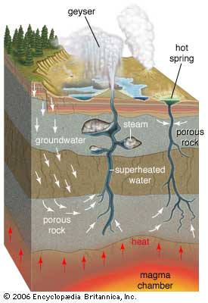
Other Types of Volcanic Activity
Geyser
Volcanic activity that does not involve the eruption of lava:
Hot springs – when groundwater heated by a nearby body of magma rises to the surface and collects in a natural pool.
Geyser – rising hot water and steam become trapped underground in narrow cracks.
Pressure builds until the water sprays above the surface.
Hot
Springs

Slide 12
Stages of a Volcano
Geologists describe volcanoes in three ways:
Active – alive
A volcano that is erupting or is showing signs that it may erupt in the near future. (Hawaii)
Dormant – sleeping
A volcano that is in a dormant phase but expected to awaken in the near future and become active. (Mt. Rainier, Washington)
Extinct – dead
A volcano that is unlikely to erupt again. (Kauai)

Slide 13
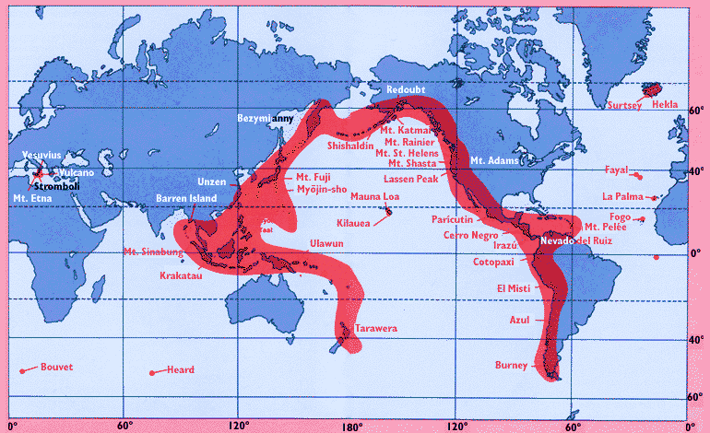
Earth’s Active Volcanoes
Most of Earth’s active volcanoes are located on the edges of the Pacific Plate = Ring of Fire

Slide 14
Volcanic Landforms
Landforms from Lava and ash:
Shield volcanoes
Composite volcanoes
Cinder cone volcanoes
Lava plateaus
Calderas
Landforms from Magma:
Volcanic neck
Dike
Sill
Batholith
Dome mountain

Slide 15
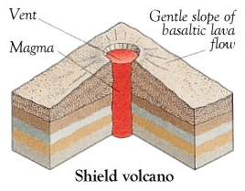
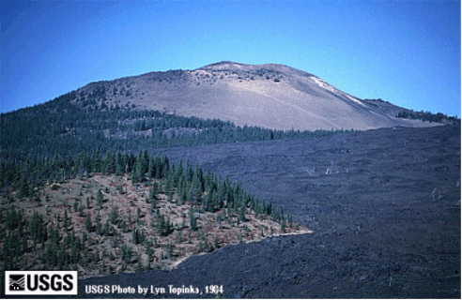
Shield Volcanoes
Wide, gently sloping mountains
Thin layers of lava pouring over previous layers
Quiet eruptions

Slide 16
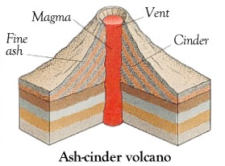
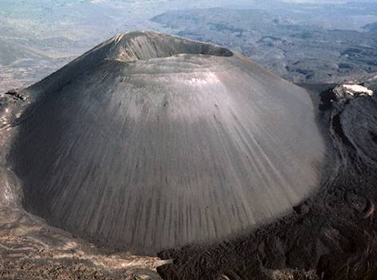
Cinder Cone Volcano
Steep, cone-shaped hill or mountain
Explosive eruption

Slide 17
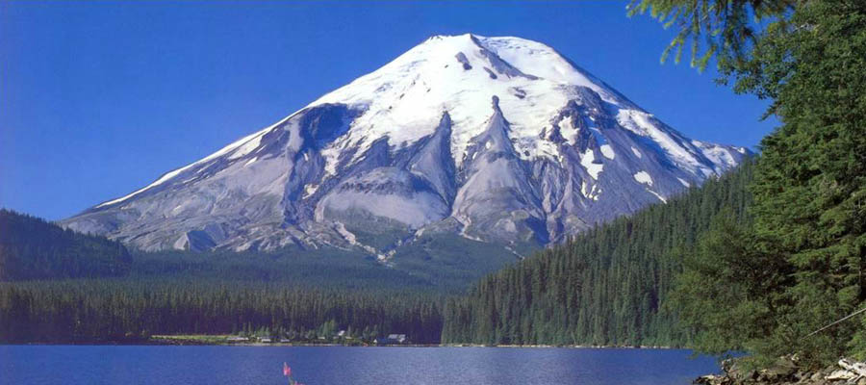
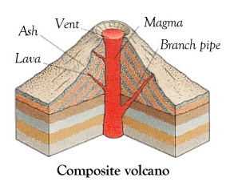
Composite Volcano
Tall, cone-shaped mountains
Layers of lava alternate with layers of ash
Explosive eruption
Mount St. Helens, Washington

Slide 18
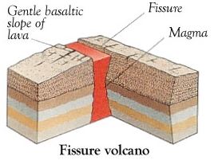
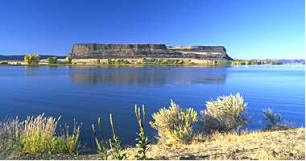
Lava Plateau
High, level area
Lava flows out from long cracks
Quiet eruption

Slide 19
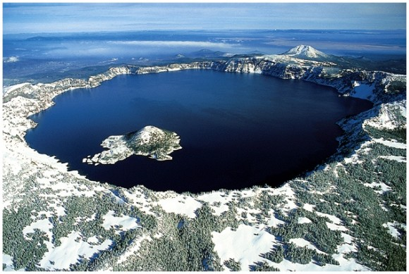
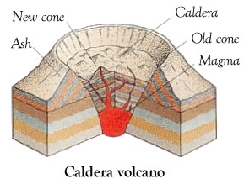
Caldera
A huge hole left by a collapsing volcanic mountain after an enormous eruption.
The main vent and magma chamber empty leaving a hollow space.
Explosive eruption

Slide 20
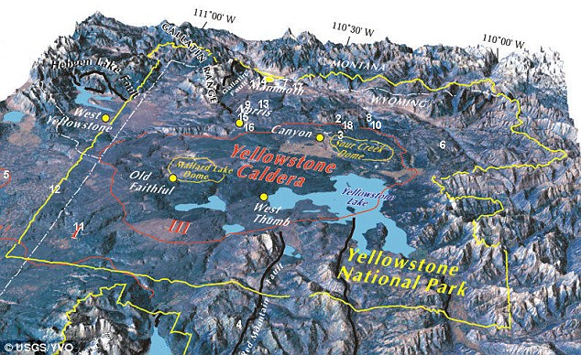
Yellow Stone National Park - Caldera

Slide 21
Yellow Stone National Park - Caldera
Super Volcano
Floor is rising at a record rate or 3 inches/yr since 2004
1000 times more powerful than Mount St. Helens eruption in 1980
Ash would be 10 ft. deep and cover an area over 1000 miles away.
2/3rd of the US would be uninhabitable due to toxic air.
Dwarf the effect of Iceland’s Eyjafjallajökull volcano (2010)
The mystery is when it will this erupt?

Slide 22
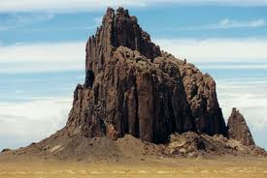
Volcanic Neck
When magma cools in a pipe and hardens.
Softer rock around the pipe wears ways, exposing the hardened magma.

Slide 23
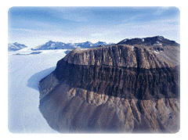
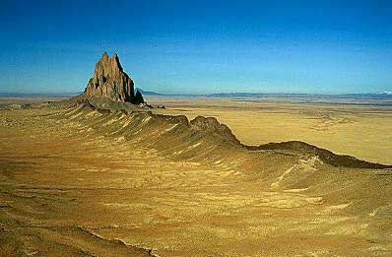
Volcanic Dike & Sill
Dike
When magma forces itself across rock layers and hardens.
Sill
When magma squeezes between layers of rock.

Slide 24
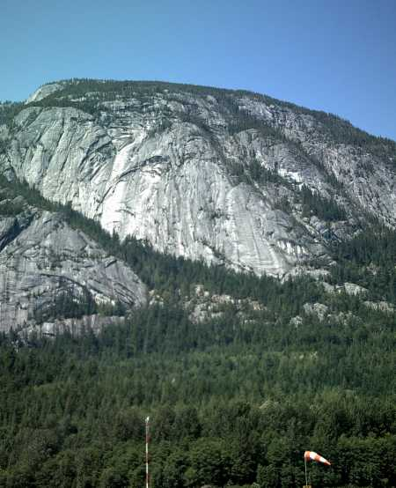
Batholiths
Large rock masses formed when a body of magma cools inside the Earth’s crust.
When the crust wears away, the hardened magma is exposed.

Slide 25
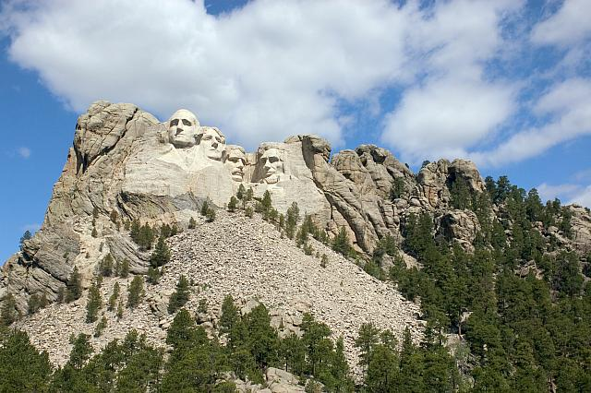
Dome Mountain
When magma is trapped in horizontal layers of rock.
Black Hills in South Dakota, Mt. Rushmore

