Slide 1
Describing Acids and Bases
Intro to Acids and Bases

Slide 2
Properties of Acids
Brainpop – Acids and Bases
Common properties:
Tastes sour
Lemons, grapefruits, oranges, limes
Reacts with metals and carbonates
Metals: Magnesium, zinc and iron produce hydrogen gas when they react with an acid and disappear = corrosive, “eat away”.
Carbonates: react to form a gas, carbon dioxide (CO2).
Reacts with an indicator
An indicator is any substance that changes color when in the presence of the substance it tests for
Cabbage Juice Indicator – turns red in the presence of an acid.
Turns blue litmus paper red.

Slide 3
Properties of Bases
Common properties:
Tastes bitter
Tonic water, soaps, shampoos and detergents
Feels slippery
Strong bases can irritate and or even burn your skin
Reacts with an indicator:
Cabbage Juice Indicator – turns blue, green or yellow in the presence of a base.
Turns red litmus blue
Remember: bases & blue!
Often described as opposite of acids.

Slide 4
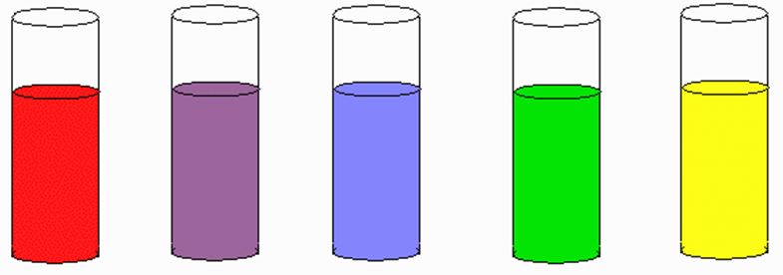
Cabbage Juice Indicator
Acidic
Neutral
Basic

Slide 5
Acids in Solution
What letter does each formula begin with?
This letter is the symbol for?
Name | Formula
Hydrochloric acid | HCl
Nitric acid | HNO₃
Sulfuric acid | H₂SO₄
Acetic acid | HC₂H₃O₂
H
Hydrogen

Slide 6
Acids in Solution
These acids are made of one or more hydrogen ions and a negative ion.
Hydrogen ion (H⁺) – an atom of hydrogen that has lost its electron.
An acid is any substance that produces hydrogen ions (H⁺) in water.
Separate into hydrogen ions (H⁺) and negative ions
Water
HCl H⁺ + Cl⁻

Slide 7
Bases in Solution
What letters does each formula end with?
These letters are the symbol for?
Name | Formula
Sodium hydroxide | NaOH
Potassium hydroxide | KOH
Calcium hydroxide | Ca(OH)₂
Magnesium hydroxide | Mg(OH)₂
OH
Hydroxide Ions

Slide 8
Bases in Solution
Hydroxide ions are negative (OH-) and made of oxygen and hydrogen.
When bases dissolve in water, positive metal ions and hydroxide ions separate.
A base is any substance the produces hydroxide ions in water.
Responsible for the bitter taste and slippery feel of bases.
Water
NaOH Na⁺ + OH⁻

Slide 9
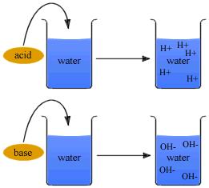
Strength of Acids and Bases
Acids and bases can be strong or weak.
Strength is based on how well an acid or base produces ions in water. (animation)

Slide 10
Strengths of Acids and Bases
Strong = most of the molecules react to form H+ or OH- ions in solution.
Strong Acids: Strong Bases:
Weak = fewer molecules react.
Weak Acids: Weak Bases:
Hydrochloric Acid
Lye
Sulfuric Acid
Sodium Hydroxide
Nitric Acid
Acetic Acid
Ammonia

Slide 11
Measuring pH
To find out the concentration of ions, chemists use a numeric scale called the pH scale.
Ranges from 0-14
Lower than 7 = acids
The lower the pH the higher the concentration of H+ molecules
7 = neutral (water)
Higher than 7 = bases
The higher the pH the lower the concentration of H+ molecules
To find the pH of a solution you can use an indicator.
Brainpop – pH Scale

Slide 12
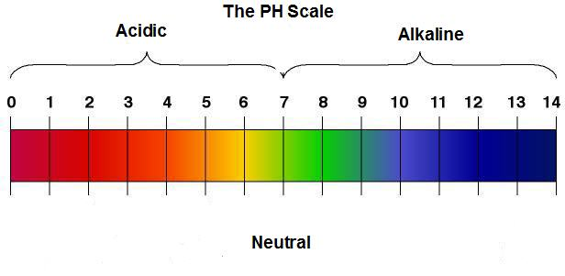
pH Scale
Acidic
Basic

Slide 13
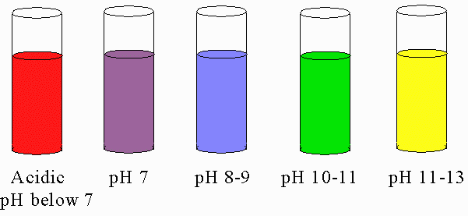
Cabbage Juice Indicator

Slide 14
Identifying Acids and Bases LAB
Substance | Red Litmus | Blue Litmus | Cabbage Juice | Acid or Base
Water | Red | Blue | Purple | Neutral
Baking Soda | Blue | Blue | Green | Base
Vinegar | Red | Red | Red | Acid
Bleach | Blue | Blue | Green | Base
Lemmon Juice | Red | Red | Red | Acid
Drano | Blue | Blue | Yellow | Base

